Slide 1




Programme Achievements
2023

Slide 2
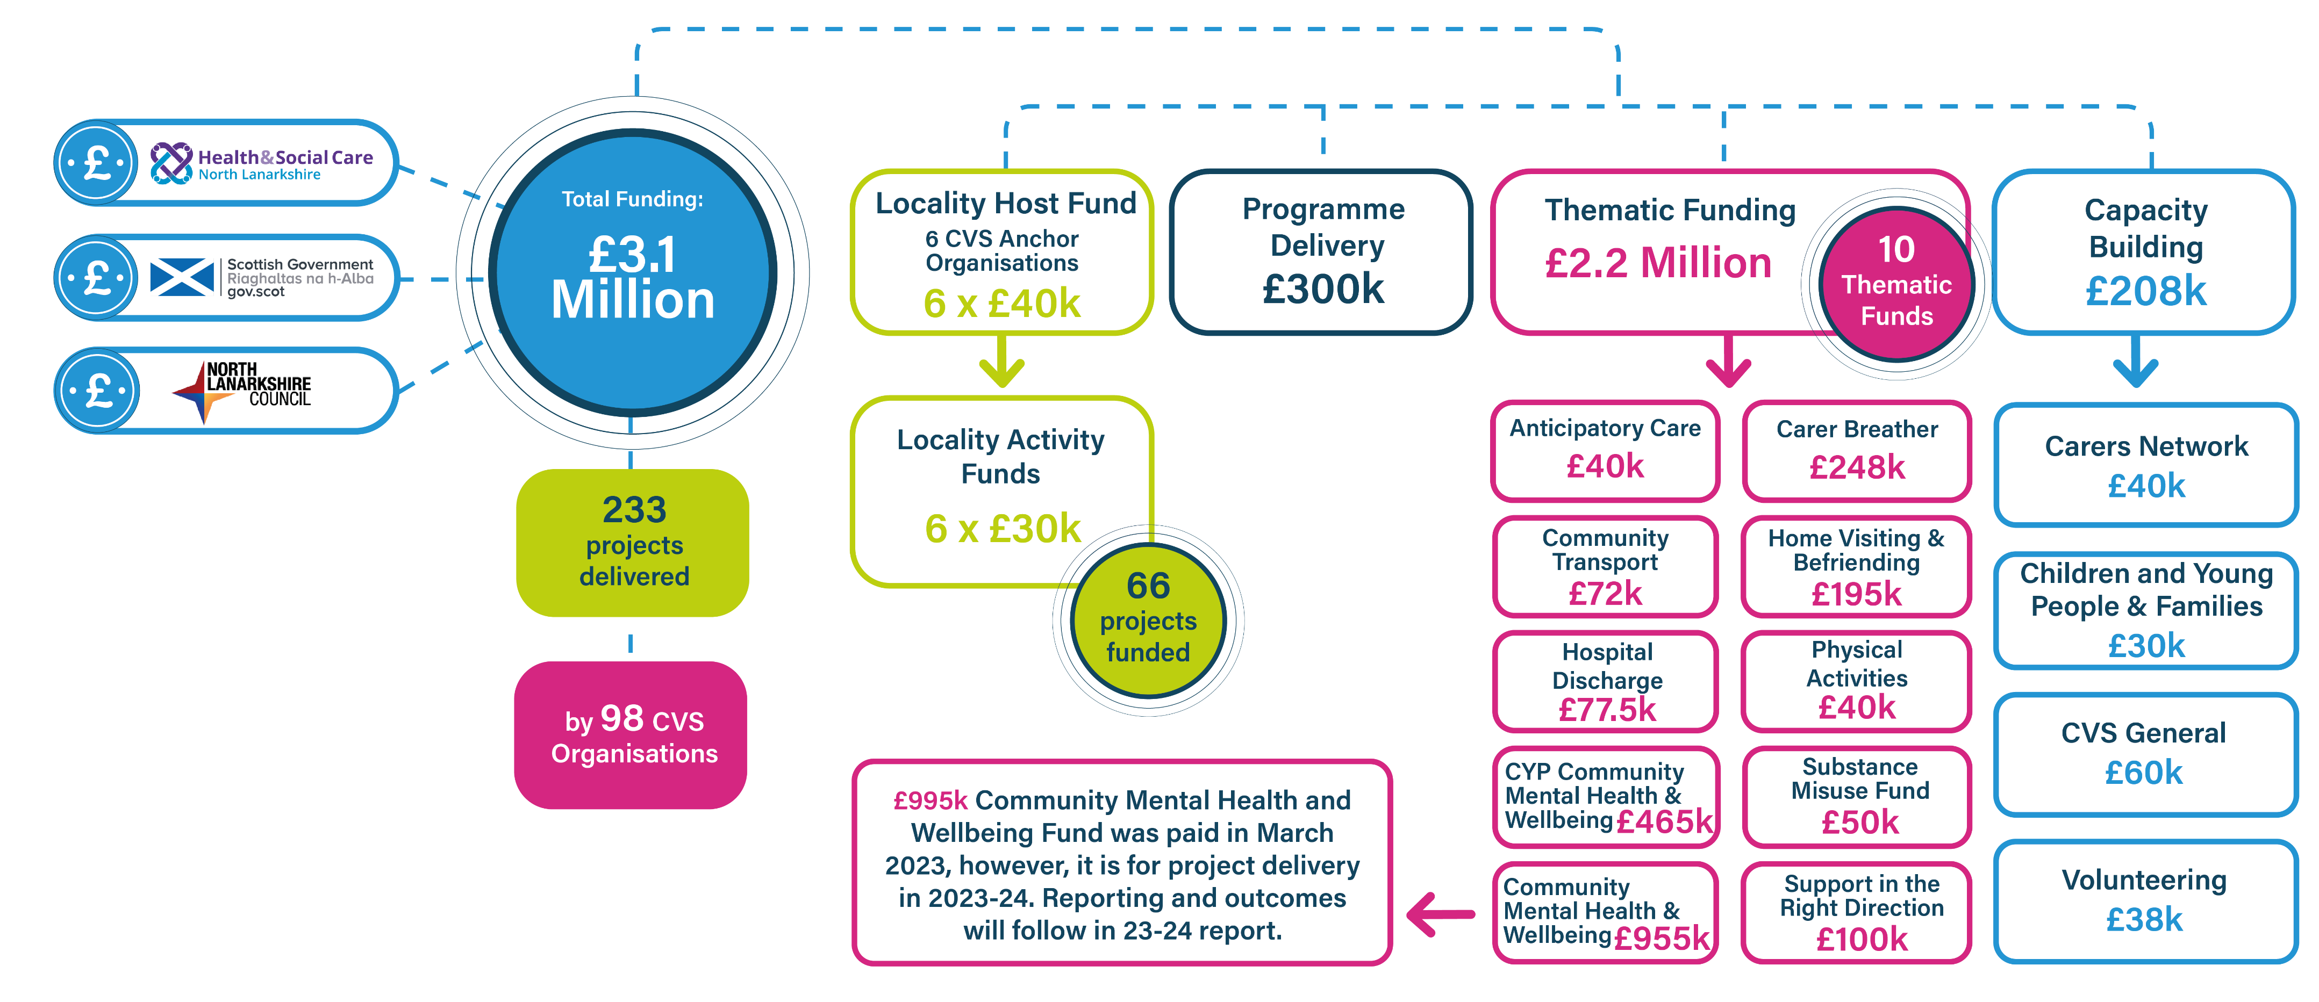
Community Solutions Achievements 2022-23
Programme funding summary

Slide 3
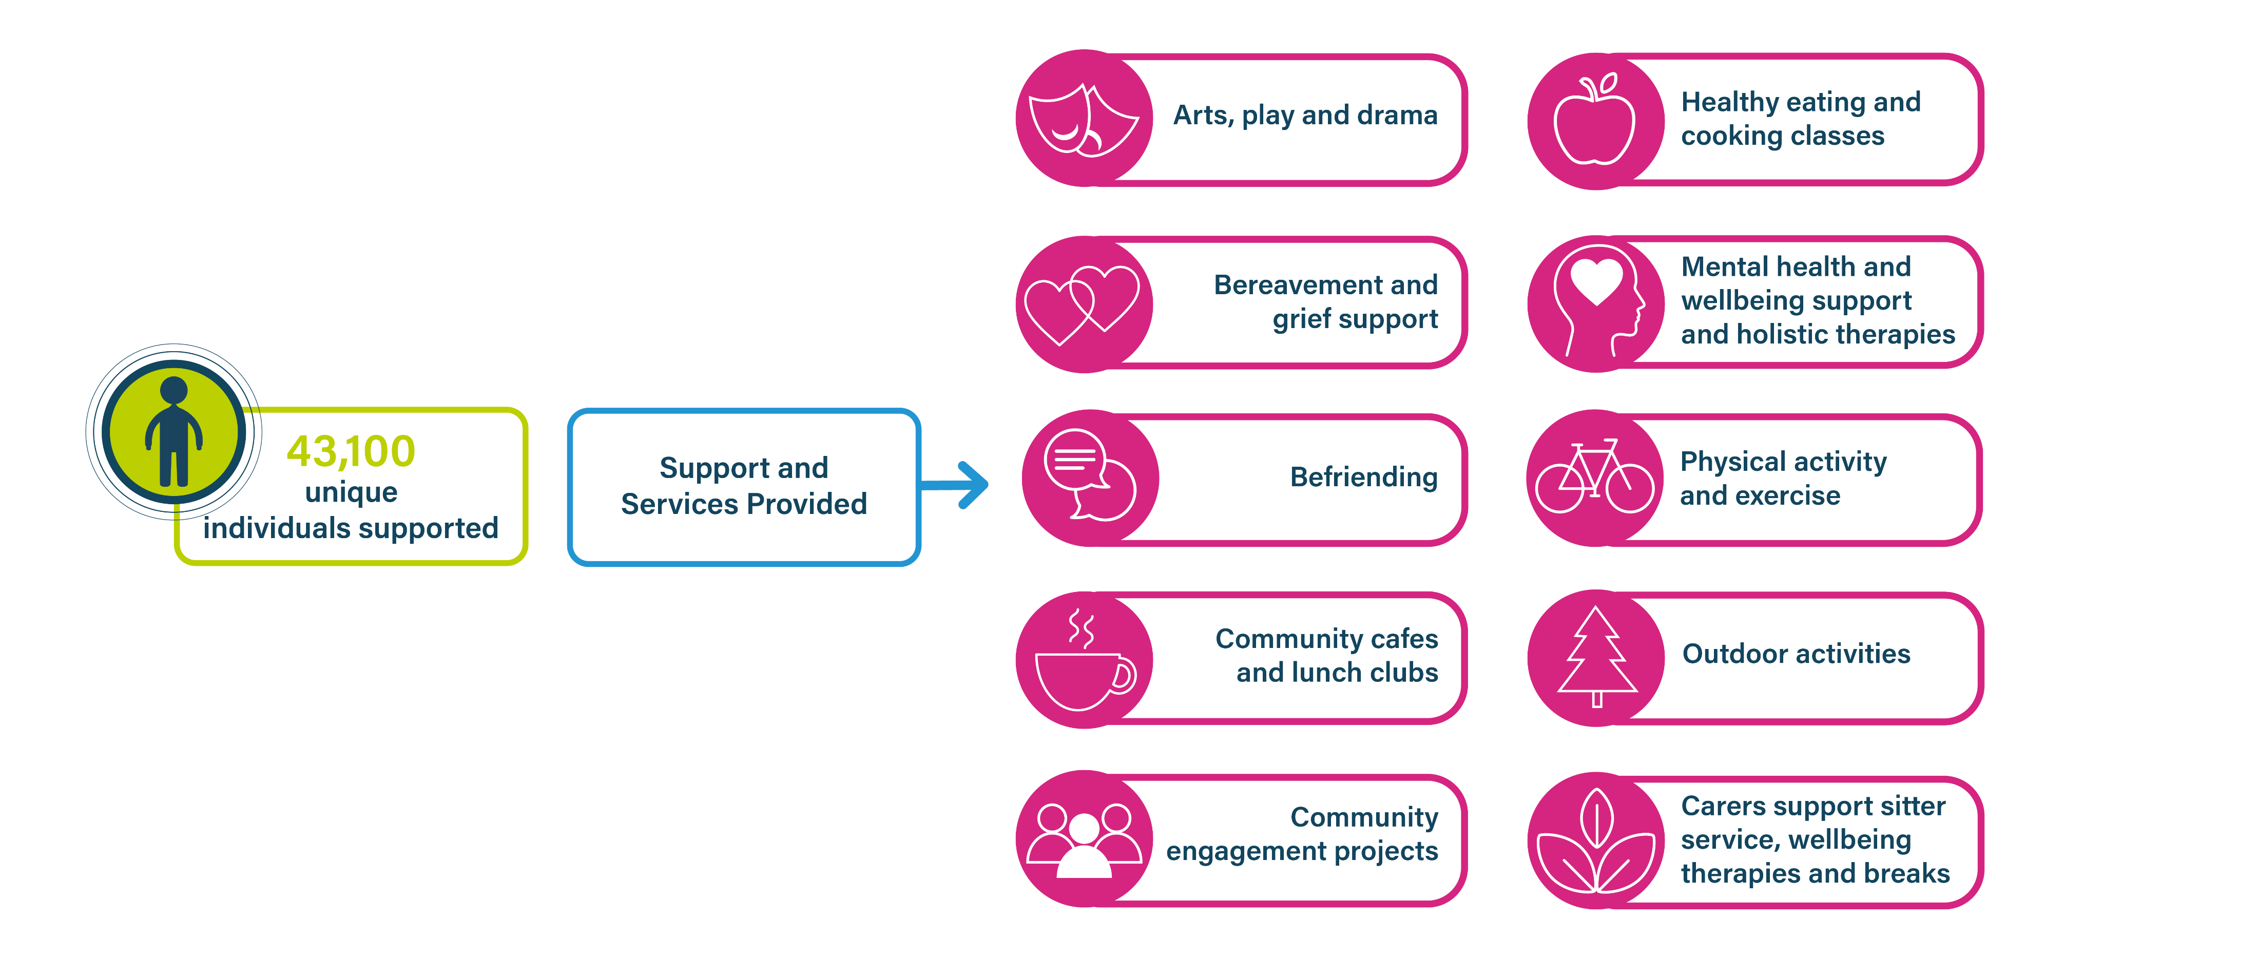
Summary of Reported Outcomes for Services Provided
Through the Community Solutions Programme 2022-23

Slide 4



Summary of Unique Individuals Supported and Services
Provided through the Community Solutions Programme 2022-23

Slide 5
Thanks
Any questions?
For more information visit: www.
Email: info@communtysolutions@vanl.co.uk

